Slide 1
Deep Learning: -- Reinforcement Learning for strategy selection
Yifei Huang
2017-11-02

Slide 2
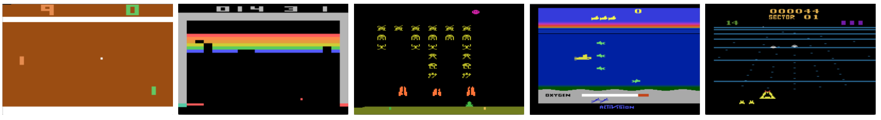
Computer can play game
Pong
Break Out
Sea Quest
Beam Rider
2013, DeepMind, https://arxiv.org/abs/1312.5602

Slide 3
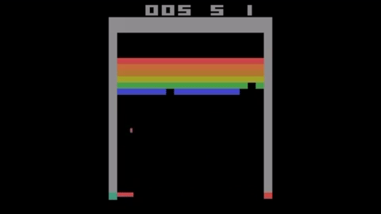
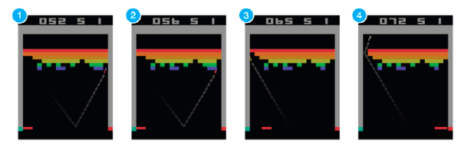
How to teach the machine to play a game?
Example: breakout (one of the Atari games)
Suppose you want to teach an agent (e.g., NN) to play this game
Supervised training (expert players play a million times) that’s not how we learn!
Reinforcement Learning
Result of training for 24 hours using GTX 980 ti.
https://github.com/devsisters/DQN-tensorflow

Slide 4
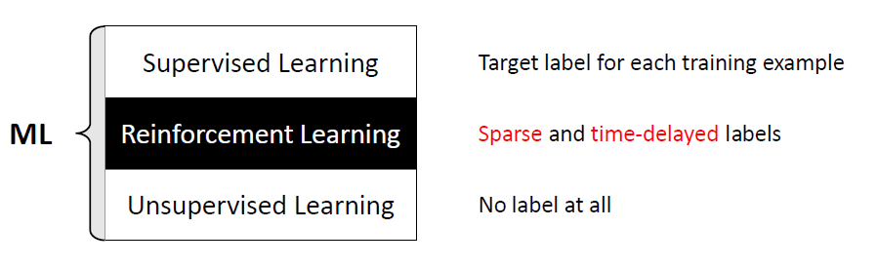
Supervised learning VS reinforcement learning VS unsupervised learning

Slide 5
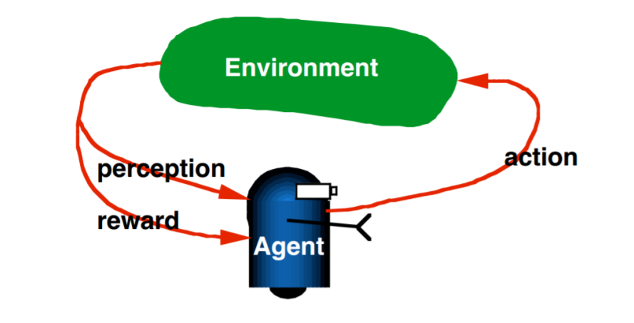
RL is learning from iteration
http://www.teach.cs.toronto.edu/~csc2542h/fall/material/csc2542f16_dqn.pdf

Slide 6
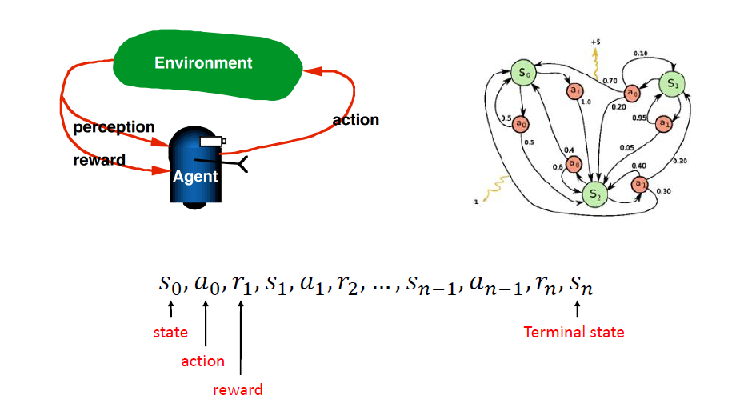
Markov Decision Process

Slide 7
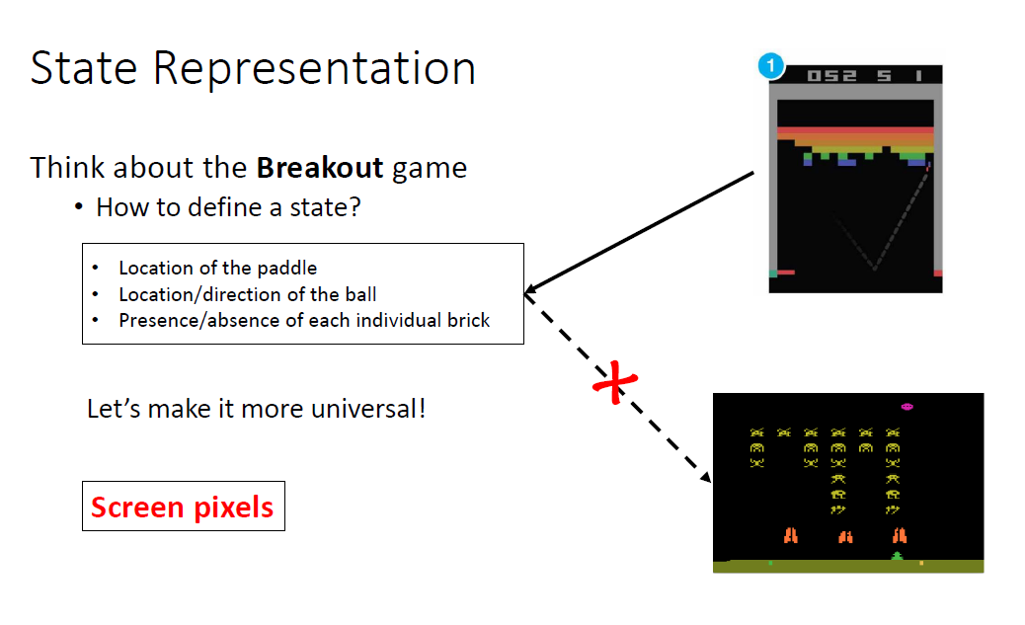
How to define a state
Universal Artificial Intelligence

Slide 8
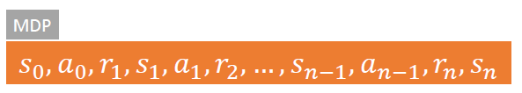
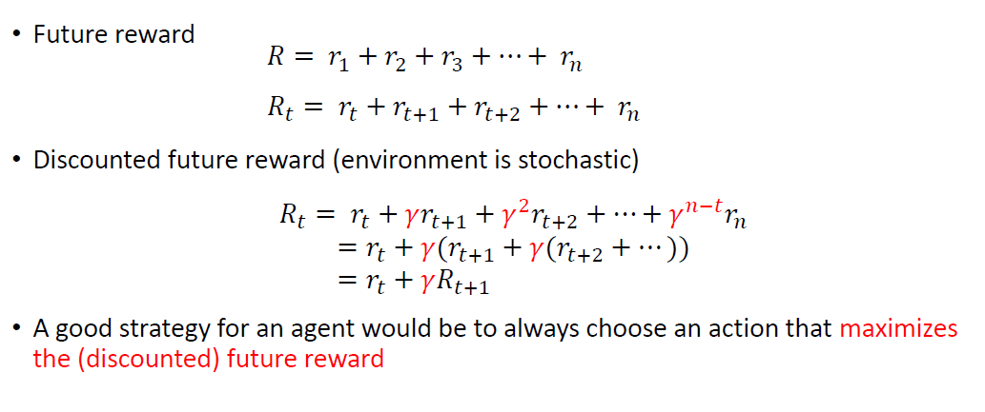
How to define a reward?
Markov Decision Processes

Slide 9
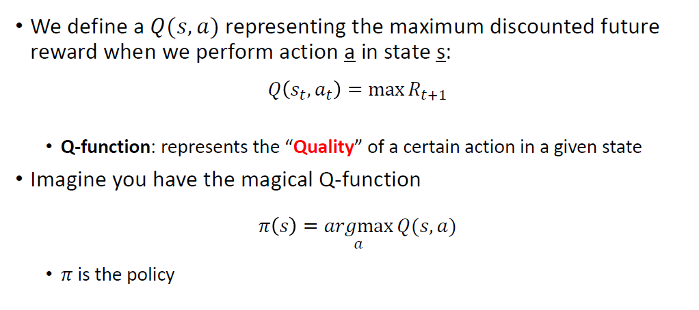
How to define an action?
Exploration VS exploitation

Slide 10
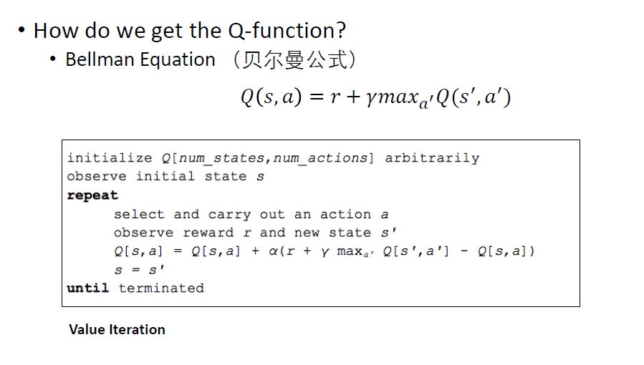
Q Learning and BellMan Equation

Slide 11
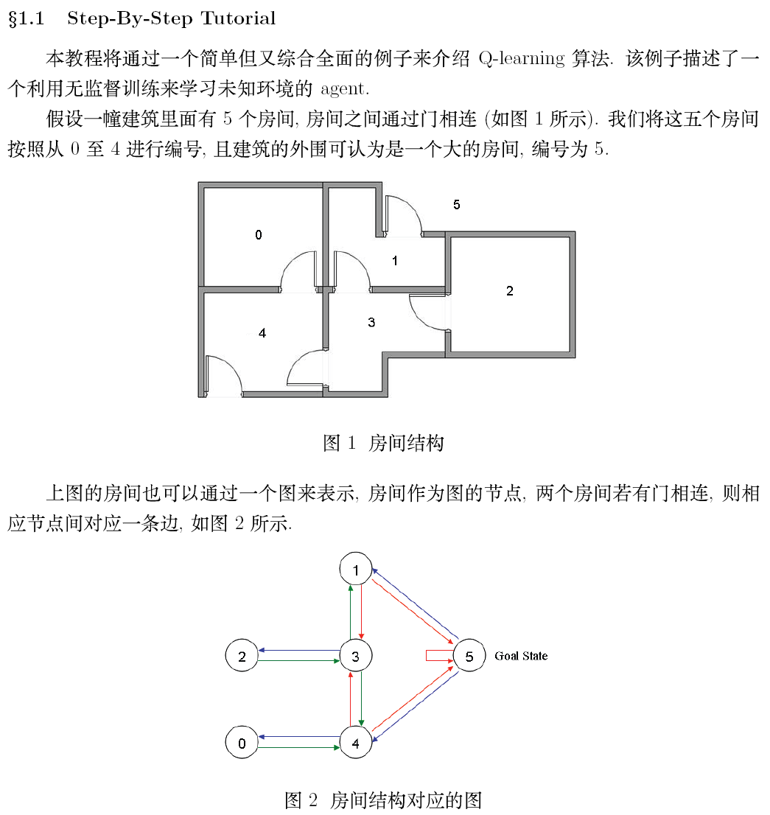
Q-Table Learning
http://fromwiz.com/share/s/1CGZRH2S1Aro2gtjMB0TJPbh2WMt0I1fPkJq26Z6cI3pS8GI

Slide 12
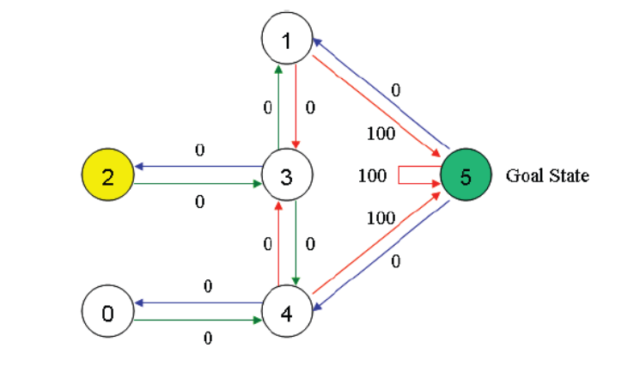
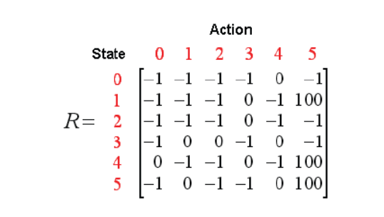
Build R-table

Slide 13
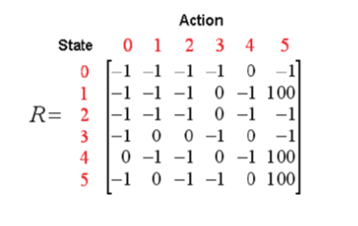
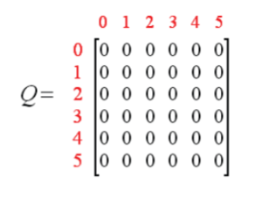
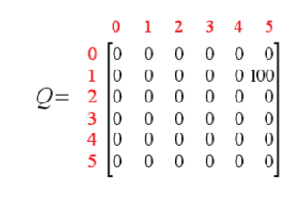
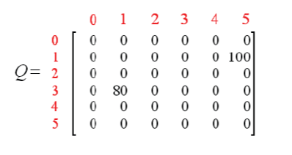
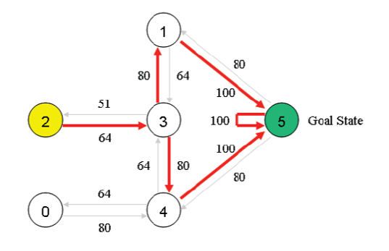
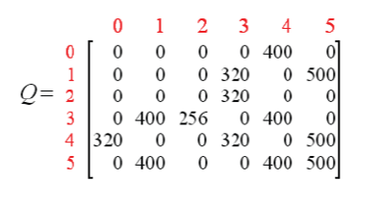
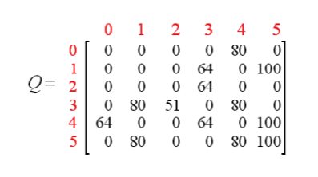
Update Q tablee

Slide 14
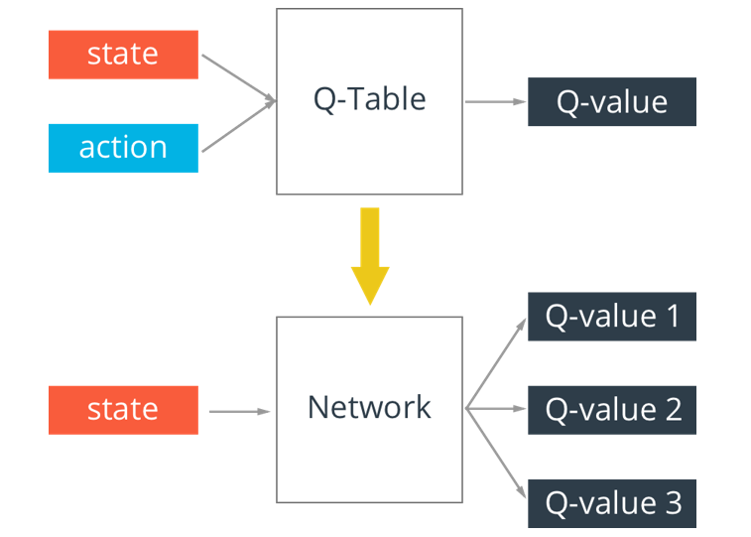
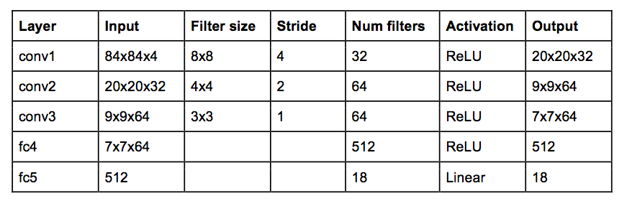
From Q-Table Learning to Deep Q-Learning
The network architecture that DeepMind used

Slide 15
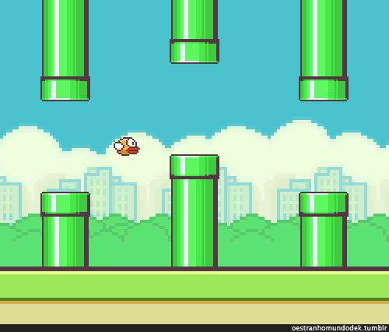
Using DQN to Play Game Flappy Bird
https://github.com/yenchenlin/DeepLearningFlappyBird

Slide 16
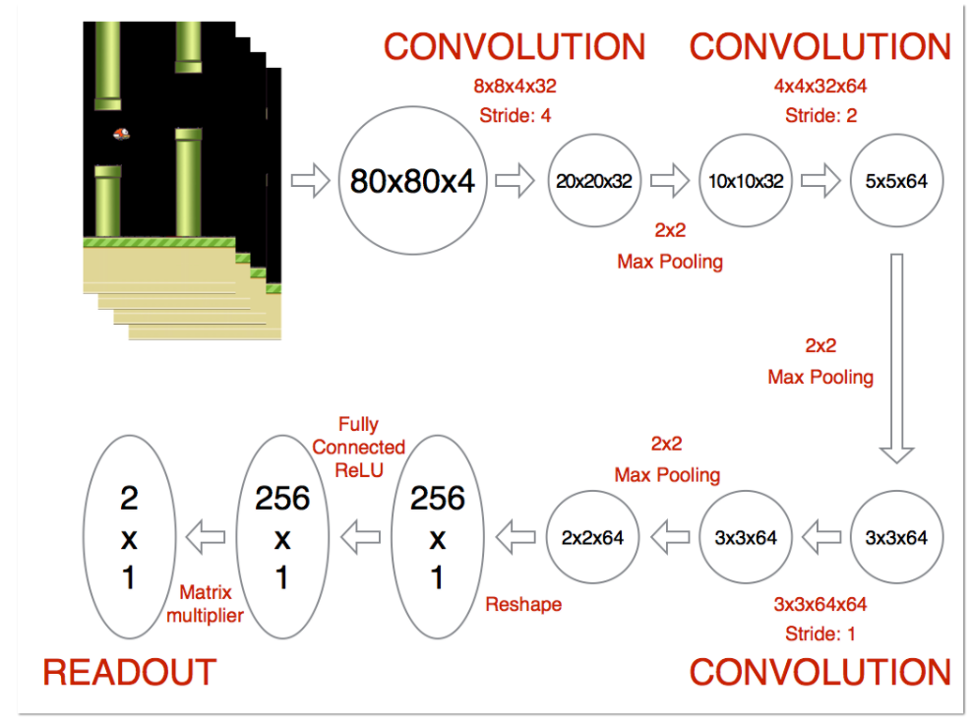

Slide 17
Reference
http://www0.cs.ucl.ac.uk/staff/D.Silver/web/Teaching.html
2013, DeepMind, https://arxiv.org/abs/1312.5602
https://github.com/devsisters/DQN-tensorflow
http://www.teach.cs.toronto.edu/~csc2542h/fall/material/csc2542f16_dqn.pdf
http://fromwiz.com/share/s/1CGZRH2S1Aro2gtjMB0TJPbh2WMt0I1fPkJq26Z6cI3pS8GI
https://github.com/yenchenlin/DeepLearningFlappyBird

